Slide 1
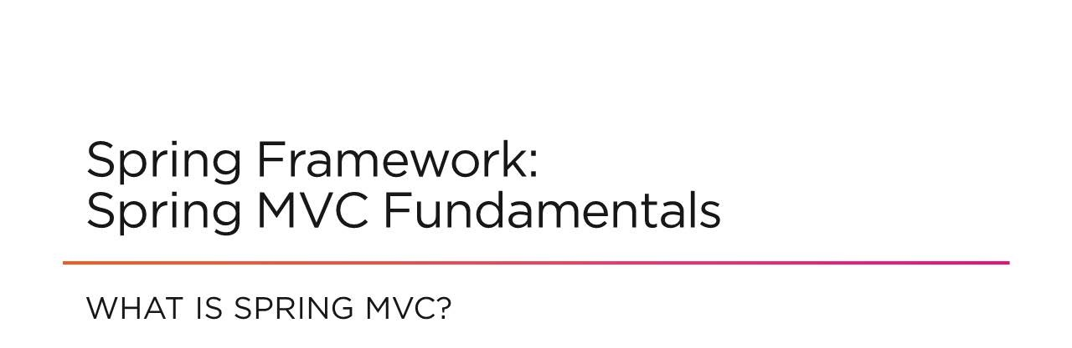

Slide 2

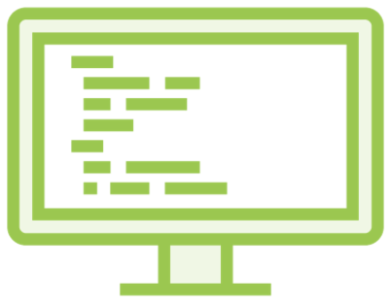

Why Spring MVC?
Frontend
REST
SPA

Slide 3

Model
View
Controller
User

Slide 4
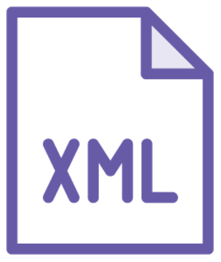
Which Framework?

Slide 5

Request / Response Lifecycle
Incoming Request
Delegate Request
Handle Request
Front Controller
Model
Controller
Backend
Return Response
Delegate Rendering
Create Model
Model
View Template
Return Control
Render Response

Slide 6
SPA
Single Page Application
DispatcherServlet
Entry point
Controller
Command Pattern Handler
RequestMapping
URL and Request Type

Slide 7
ViewResolver
Locates View to serve
servlet-config
Configuration file
POJO
Plain Old Java Object
Bean
Spring configured POJO

Slide 8

Frontend, REST, SPA
MVC
Summary
No XML
Request / Response Lifecycle Vocabulary
What are we building?

